Slide 1
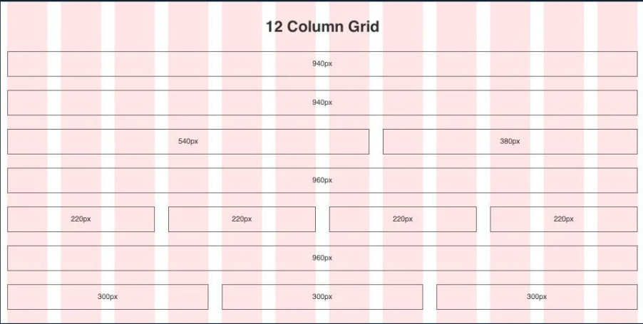

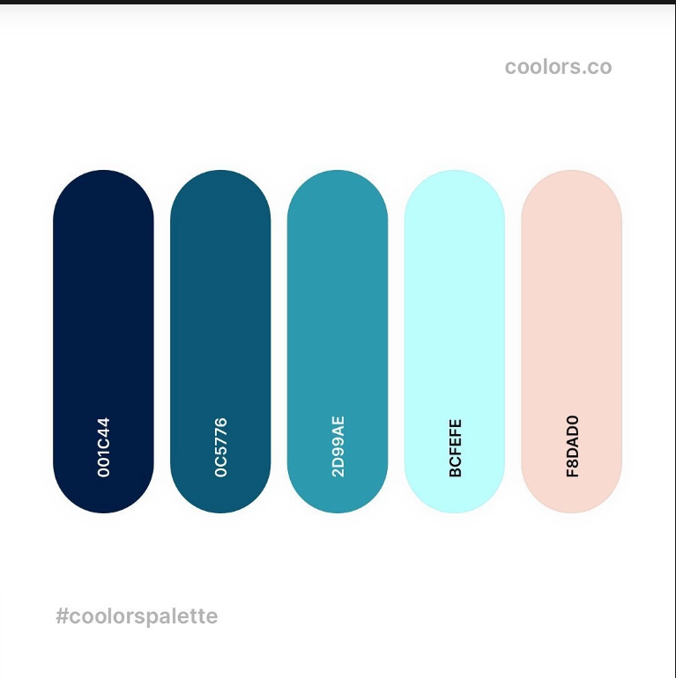
FnK

Slide 2
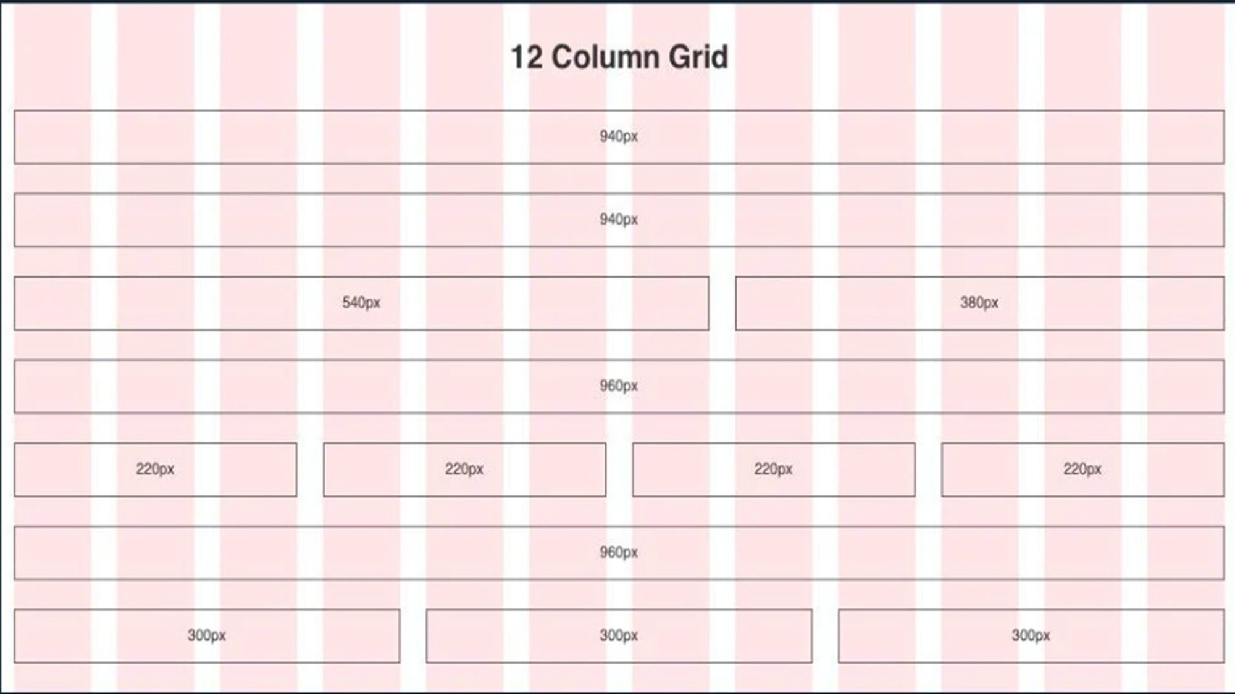



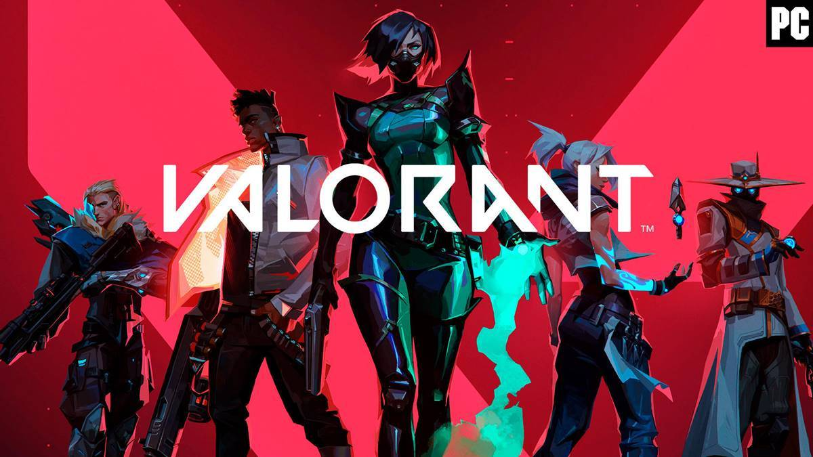





Đăng kí
|Đăng nhập
FnK
FPS
MOBA
SIMULATION
ADVENTURE
RECOMMENDED FOR YOU
TRENDING

Slide 3

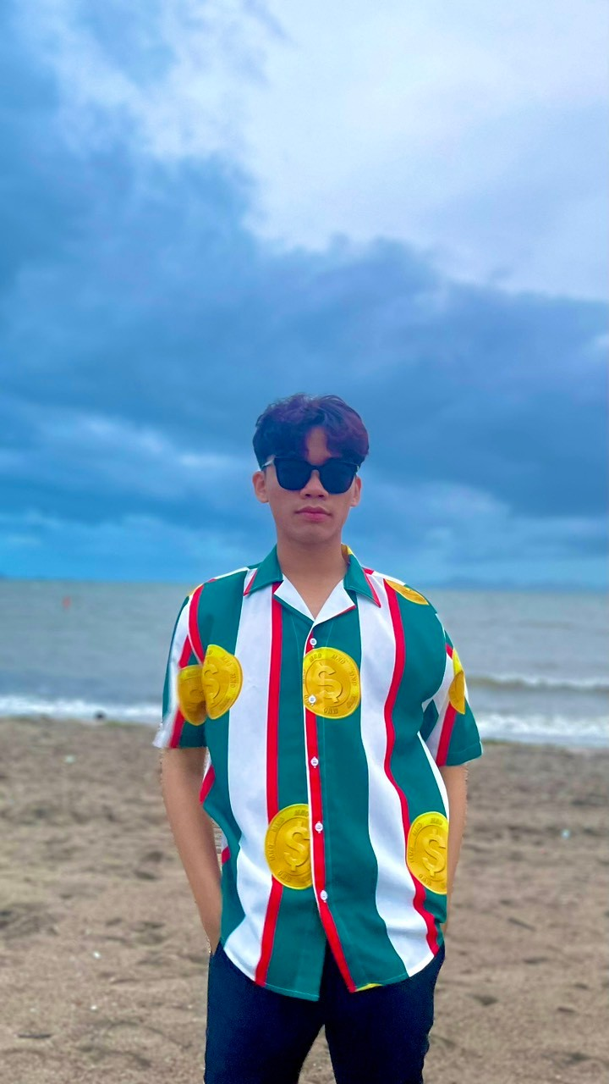

Hi, It' s me
I'm Khoa
This web is my project.....

Slide 5
Hi, It' s me
I'm Khoa
This web is my project.....

Slide 6
Đăng kí
|Đăng nhập
FnK
FPS
MOBA
SIMULATION
ADVENTURE
RECOMMENDED FOR YOU
TRENDING

Slide 7


Đăng kí
|Đăng nhập
FnK
FPS
MOBA
SIMULATION
ADVENTURE
RECOMMENDED FOR YOU
TRENDING
SHOW MORE

Slide 8
RECOMMENDED FOR YOU
Đăng kí
|Đăng nhập
FnK
FPS
MOBA
SIMULATION
ADVENTURE
TRENDING
SHOW MORE
SHOW MORE
SHOW MORE

Slide 9
RECOMMENDED FOR YOU
Đăng kí
|Đăng nhập
FnK
FPS
MOBA
SIMULATION
ADVENTURE
TRENDING
SHOW MORE
SHOW MORE
SHOW MORE

Slide 10
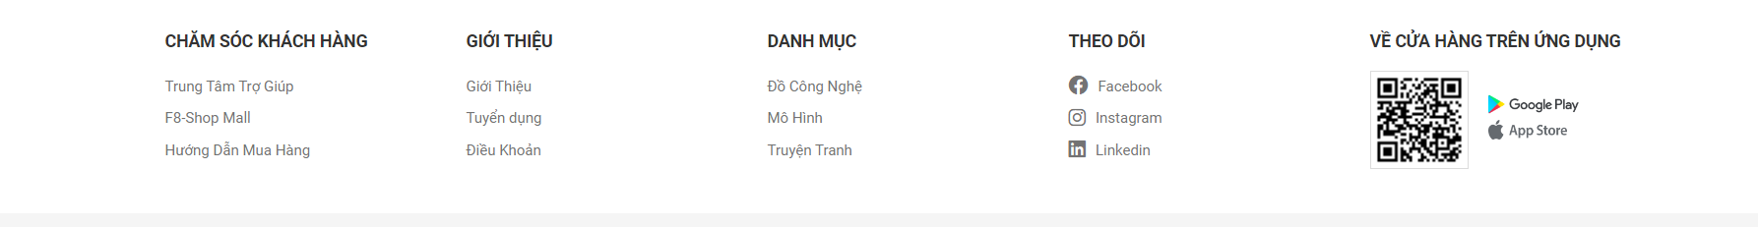
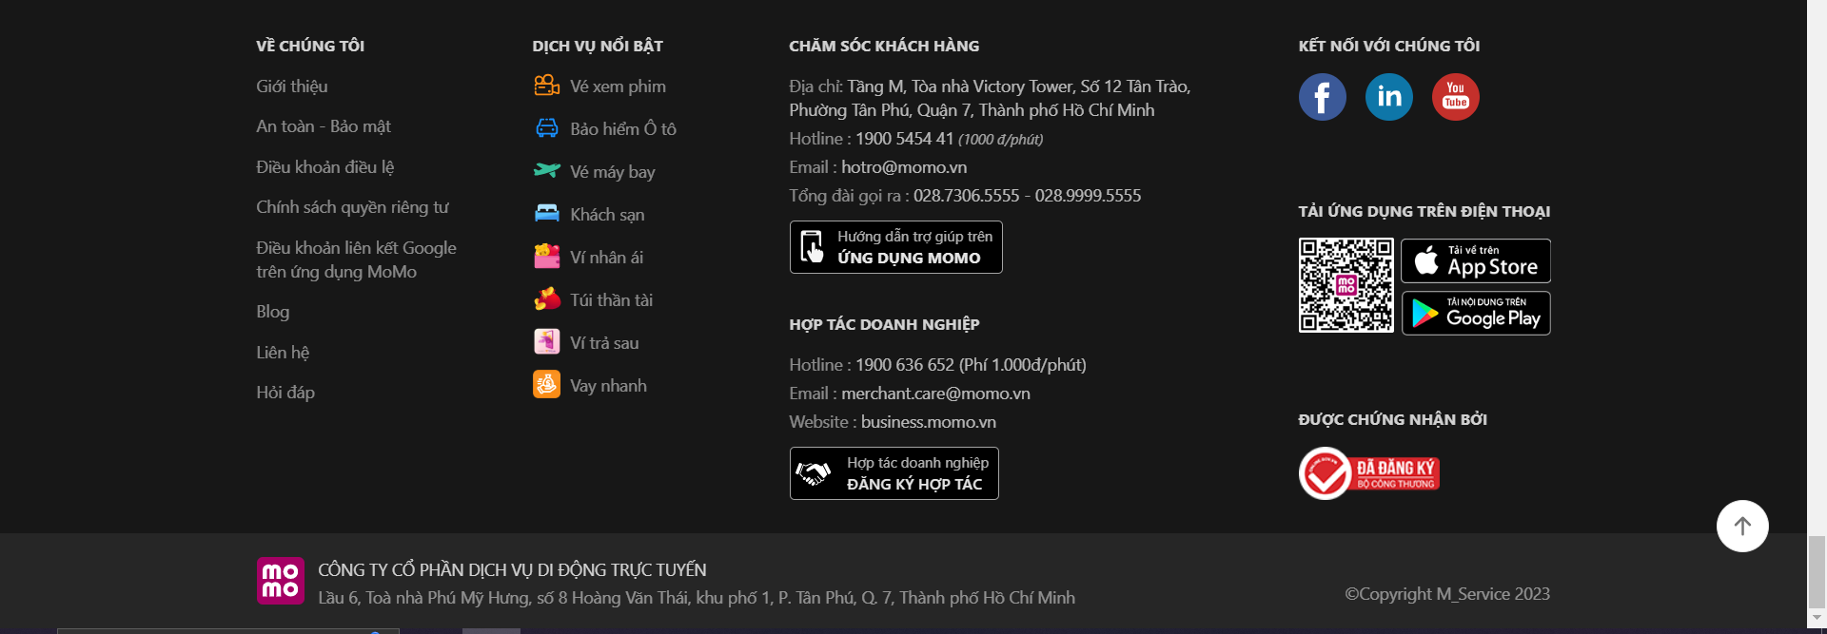

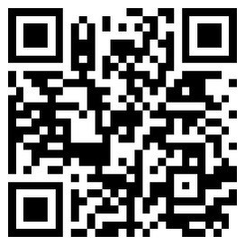


DANH MỤC
THEO DÕI
LIÊN HỆ
Fps
Instagram
Moba
Github
Adventure
Facebook
Simulation

Slide 12
FnK

Slide 13
FnK

Slide 14
Home

Slide 15
Game

Slide 16
Beta

Slide 17
About

Slide 18

GameVerse

